Slide 1
Chapter 4: Pathfinding
Agenda
  Introduction
  Uniform Cost Search (UCS)
  Dijkstra’s algorithm
  The A* Pathfinder
CW208-3-2014/15, Lecture 17

Slide 2
Dijkstra’s algorithm
Dijkstra’s algorithm is a variant of UCS
There is no goal state
Processing continues until all nodes have been removed from the priority queue, i.e. until shortest paths to all nodes (not just a goal node) have been determined
CW208-3-2014/15, Lecture 17

Slide 3
Dijkstra’s algorithm
Like UCS Dijkstra’s algorithm is not a directed algorithm and it searches in every direction for the best (shortest) path.
Some definitions:
  V is the set of all vertices (nodes) in the graph G
  Each edge/arc of the graph is an ordered pair of nodes (u,v) representing a connection from node u to node v
  The set of all edges is denoted E
  Weights of edges are given by a weight function:
  w: E → [0, ∞];
  therefore w(u,v) is the non-negative cost of moving from vertex u to vertex v.
CW208-3-2014/15, Lecture 17

Slide 4
Dijkstra’s algorithm
Principle of Dijkstra’s algorithm:
  For each node v, we keep the cost of the shortest path found so far between the starting node (s) and v.
Initially, this value is 0 for the starting node s (d[s]=0), and infinity for all other nodes
This is because we do not know any path leading to those nodes (d[v]=∞ for every v in V, except s).
CW208-3-2014/15, Lecture 17

Slide 5
Dijkstra’s algorithm
When the algorithm finishes, d[v] will be the cost of the shortest path from s to v OR infinity, if no such path exists.
Here’s a version of Dijkstra’s algorithm:
CW208-3-2014/15, Lecture 17

Slide 6
Dijkstra’s algorithm
  Let s = the starting node
  Let pq = a new priority queue
  Initialise d[s] to 0
  For each node v in graph G
  Initialise d[v] to infinity // don’t yet know the distances to these nodes
  Add s to the pq
  Mark(s)
  While the queue is not empty
  For each child node c of pq.top()
  If (c != previous(pq.top()) // don’t go back to a predecessor
  Let distC = w(pq.top(), c) + d[pq.top]
  If ( distC < d[c] )
  let d[c] = distC
  Set previous pointer of c to pq.top()
  End if
  If (notMarked(c))
  Add c to the pq
  Mark(c)
  End if
  End if
  End for
  Remove pq.top()
  End while
CW208-3-2014/15, Lecture 17

Slide 7
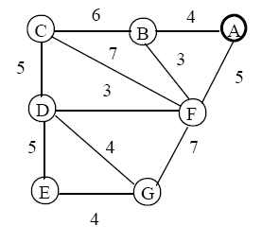
Class Exercise
The following graph represents city landmarks and the driving time between them
Plot the route taken by Dijkstra’s algorithm from A to E
CW208-3-2014/15, Lecture 17

Slide 8
Class Exercise
In particular, show the following:
1. The current node being expanded
2. The path cost evaluated for any child nodes of the current node.
3. The previous pointer for each child node
4. The state of the priority queue and the end of each iteration
CW208-3-2014/15, Lecture 17

Slide 9
Dijkstra’s algorithm
We can read the shortest path from the starting node to the destination node by iteration:
    Let nodeList = emptyList
    Let u = a destination node
    While defined previous[u]
    Insert u to the beginning of nodeList (i.e. prepend)
    Let u = previous[u]
    End while
CW208-3-2014/15, Lecture 17

Slide 10
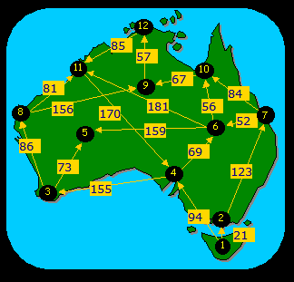
Class Exercise
The following is a map of Australia with flying times between major towns/cities
Plot the route taken by Dijkstra’s algorithm from 1 to 12
Interactive version here:
http://www.ifors.ms.unimelb.edu.au/tutorial/dijkstra/island.html
CW208-3-2014/15, Lecture 17

Slide 11
A* Pathfinder
The A* algorithm is the most commonly used pathfinder in computer games
A* is a combination of Dijkstra’s algorithm and a heuristic pathfinder
A heuristic is effectively a process for evaluating each node based on its distance from the goal
A* always selects the node that is closest to the goal and is a directed algorithm for pathfinding
It searches for the best path in the direction of the goal.
CW208-3-2014/15, Lecture 17

Slide 12
A* Pathfinder
Clearly, the shortest path from the start to the goal is what is desired
The fundamental workings of A* can be summarised as:
“calculate the heuristic value of each cell as the combination of the actual distance it takes to get to that cell and the estimated distance from that cell to the goal”
CW208-3-2014/15, Lecture 17

Slide 13
A* Pathfinder
More formally, the A* employs an evaluation function:
  f(n) = h(n) + g(n)
where:
    h(n) = estimated cost to goal from n
    g(n) = cost so far to reach n
    f(n) = estimated total cost of the path through n to goal
Consider an example:
CW208-3-2014/15, Lecture 17

Slide 14
A* Pathfinder
Path 1 example: The function does not yet know the path from this cell to cell
G, so it estimates the length by using a straight line (4.12)
f(n) = 4.12 + 2.41 = 6.53
 |  | S |  |  |  |  |  | G
4.12
1.00
1.41
2.00
6.32
Path 2 example: The function does not yet know the path from this cell to cell
G, so it estimates the length by using a straight line (6.32)
f(n) = 6.32 + 2.00 = 8.32
CW208-3-2014/15, Lecture 17

Slide 15
A* algorithm
  Let s = the starting node, g = goal node
  Let pq = a new priority queue
  Initialise g[s] to 0
  For each node v in graph G
  Calculate h[v] // Compute estimated distance to goal for each node.
  Initialise g[v] to infinity // Don’t yet know the distances to these nodes
  Add s to the pq
  Mark(s)
  While the queue is not empty AND pq.top() != g
  For each child node c of pq.top()
  If (c != previous(pq.top() AND c has not been removed from the pq)
  Let distC = h(c) + g(c) // g(c) is actual path cost to child
  If ( distC < f(c) )
  let f[c] = distC
  Set previous pointer of c to pq.top()
  End if
  If (notMarked(c))
  Add c to the pq
  Mark(c)
  End if
  End if
  End for
  Remove pq.top()
  End while
CW208-3-2014/15, Lecture 17

Slide 16
A* Pathfinder
Class Exercise:
A tile-based game is using the A* pathfinding algorithm to calculate the shortest path from the starting cell B3 to the destination cell F3. The shaded cells below indicate impassable areas.
CW208-3-2014/15, Lecture 17

Slide 17
A* Pathfinder
 | A | B | C | D | E | F
0
1
2
3
4
5
6
7
CW208-3-2014/15, Lecture 17

Slide 18
A* Pathfinder
Iteration #1
Expand B3
B2: sqrt(16 + 1) + 1 = 4.12
B4: sqrt(16 + 1) + 1 = 4.12
A4: sqrt(25 + 1) + 1.41 = 6.50
A3: sqrt(25) + 1 = 6
A2: sqrt(25 + 1) + 1.41 = 6.50
PQ Finished
B2(4.12)=>B3 B3
B4(4.12)=>B3
A4(6.50)=>B3
A3(6)=>B3
A2(6.50)=>B3
CW208-3-2014/15, Lecture 17

Slide 19
A* Pathfinder
Iteration #2
Expand: B2
B1: sqrt(16 + 4) + 2 = 6.47
C1: sqrt(9 + 4) + 2.41 = 6.01
B3: <no eval>
A3: sqrt(25) + 2.41 = 7.41 (retain old path)
A2: sqrt(25 + 1) + 2 = 7.09 (retain old path)
A1: sqrt(25 + 4) + 2.41 = 7.79
PQ Finished
B4(4.12)=>B3 B3, B2
A4(6.50)=>B3
A3(6)=>B3
A2(6.50)=>B3
B1: (6.47)=>B2
C1: (6.01)=>B2
A1: (7.79)=>B2
CW208-3-2014/15, Lecture 17

Slide 20
A* Pathfinder
Iteration #3
Expand: B4
C5: sqrt(9 + 4) + 2.41 = 6.01
B5: sqrt(16 + 4) + 2 = 6.47
A4: sqrt(25 + 1) + 2 = 7.09 (retain old path)
A3: sqrt(25) + 2.41 = 7.41 (retain old path)
B3 <no eval>
PQ Finished
A4(6.50)=>B3 B3, B2, B4
A3(6)=>B3
A2(6.50)=>B3
B1: (6.47)=>B2
C1: (6.01)=>B2
A1: (7.79)=>B2
C5: (6.01)=>B4
B5: (6.47)=>B4
CW208-3-2014/15, Lecture 17

Slide 21
A* Pathfinder
Iteration #4
Expand A3
A2 : sqrt(25 + 1) + 2 = 7.09 (retain old)
B2: <no eval>
B3: <no eval>
B4: <no eval>
A4: sqrt(25 + 1) + 2 = 7.09 (retain old)
PQ Finished
A4(6.50)=>B3 B3, B2, B4, A3
A2(6.50)=>B3
B1: (6.47)=>B2
C1: (6.01)=>B2
A1: (7.79)=>B2
C5: (6.01)=>B4
B5: (6.47)=>B4
CW208-3-2014/15, Lecture 17

Slide 22
A* Pathfinder
Class Exercise
  The following graph represents city landmarks and the driving time between them
  Show the following:
    1. The node to be expanded at the start of the iteration.
    2. The evaluation function f(n) for each child node.
    3. The nodes in the priority queue (pq) and the previous pointer for each node.
    4. The list of nodes removed from the pq.
CW208-3-2014/15, Lecture 17

Slide 23
A* Pathfinder
10
12
8
4
7
h(n) = Heuristic value
of the node – the estimated
driving time to E
0
3
CW208-3-2014/15, Lecture 17

Slide 24
A* Pathfinder
For the algorithm to give the shortest path, the heuristic must be admissible
This means the heuristic must never overestimate.
CW208-3-2014/15, Lecture 17

Slide 25
A* Pathfinder
The heuristic is used to control A*’s behaviour:
  If h(n) is 0, then g(n) only plays a role and A* turns into Dijkstra's algorithm
  If h(n) is always < the cost of moving from n to the goal, then A* is guaranteed to find a shortest path...lower h(n)’s make A* run more slowly...
  If h(n) exactly equals the cost of moving from n to the goal, then A* will only follow the best path and never expand anything else (runs quickly)
CW208-3-2014/15, Lecture 17

Slide 26
A* Pathfinder
The heuristic is used to control A*’s behaviour:
  If h(n) is sometimes > cost of moving from n to the goal, then A* is not guaranteed to find a shortest path, but it can run faster.
To summarise:
  h(n) too low, A* will find right paths but performs slowly
  h(n) too high, no guarantee A* will find shortest paths, but will run faster
CW208-3-2014/15, Lecture 17

Slide 27
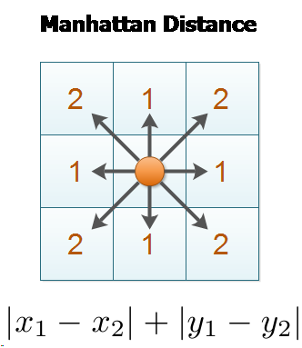
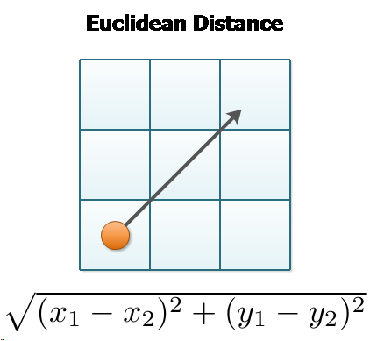
A* Pathfinder
Methods for calculating the heuristic
For tile-based games, possibilities are Manhattan distance and Euclidean distance
  On a square grid with 4 directions of movement, use Manhattan distance
  On a square grid with any
  allowable direction of
  movement,
  use Euclidean distance
CW208-3-2014/15, Lecture 17

Slide 28
A* Pathfinder
Methods for calculating the heuristic
For non-tile based games, a heuristic to approximate the length of the path between any two points can be calculated as follows:
  Fit a coarse grid on top of the fine grid and precompute the shortest path between any pair of coarse grid locations.
  Precompute the shortest path between any pair of waypoints....this is a generalization of the coarse grid approach.
CW208-3-2014/15, Lecture 17

Slide 29
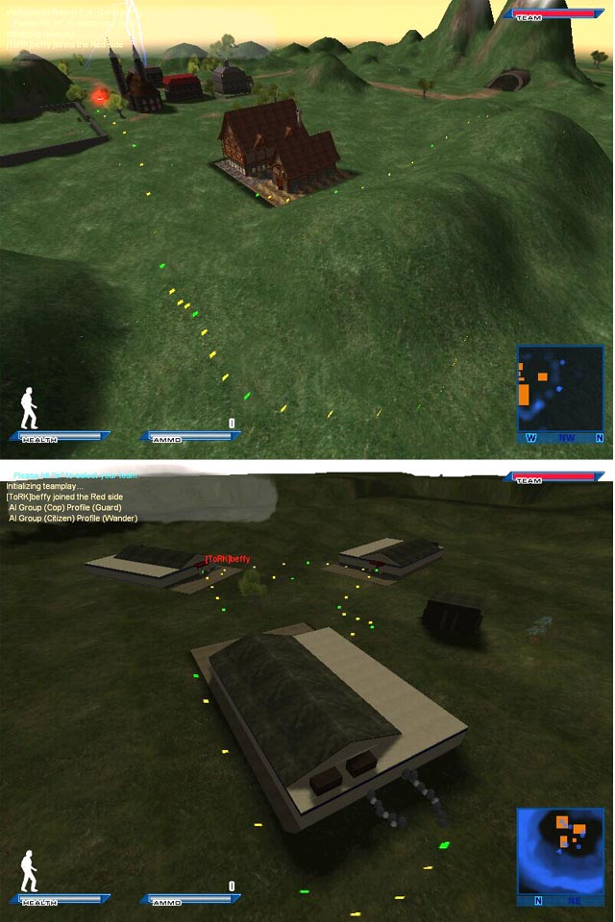
Green rectangles
Are the main path nodes
Yellow rectangles
represent are “spline
interpolation” nodes to
smoothen the overall
path
CW208-3-2014/15, Lecture 17

Slide 30
A* Pathfinder
Add in a heuristic h' that estimates the cost of going from any location to nearby waypoints. (This can be precomputed too)
The final heuristic will be:
  h(n) = h'(n, w1) + distance(w1, w2) + h'(w2, goal)
A more accurate (but expensive) heuristic will evaluate the above with all pairs w1, w2 that are close to the node and the goal, respectively.
CW208-3-2014/15, Lecture 17

Slide 31
Dijkstra’s algorithm and A*
A* is much faster than undirected graph traversal algorithms such as breadth-first (why?) and can be more efficient than other goal-state pathfinders such as UCS (why?)
Consider a comparison of how both Dijkstra's and A* pathfinders might find the same goal:
CW208-3-2014/15, Lecture 17

Slide 32
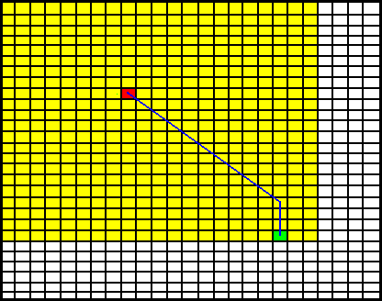
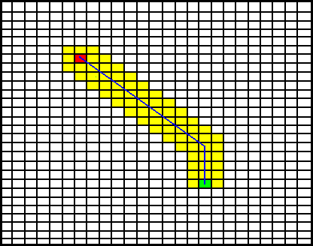
Pathfinding
Dijkstra’s Algorithm A* Algorithm
A* is a directed algorithm (Dijkstra’s is undirected), so
A* searches much less area and the result is faster searching.
CW208-3-2014/15, Lecture 17

Slide 33
Dijkstra’s algorithm and A*
In cases where there are multiple possible destinations, we must repeatedly call A* to find the distance to each one, then choose that path.
In these cases Dijkstra's is a better choice than A* as we don't know which one is closest.
CW208-3-2014/15, Lecture 17

Slide 34
A* Pathfinder
Further reading on A*:
http://www.policyalmanac.org/games/aStarTutorial.htm
http://theory.stanford.edu/~amitp/GameProgramming/Heuristics.html
http://blog.nobel-joergensen.com/2011/02/26/a-path-finding-algorithm-in-unity/
CW208-3-2014/15, Lecture 17

Slide 35
Line-based pathfinding
Not many games are tile based, i.e. players are not restricted to occupying certain tiles in a game
Pathfinding for non-tile based games can be complex, so simple methods are often used
The following example illustrates a simple technique to find a path around an obstacle:
CW208-3-2014/15, Lecture 17

Slide 36

Pathfinding
The lines represent a pre-generated
path around the obstacle – stored as
an array of vectors.
If the player gets too close to an
obstacle, they can attach to the path
around the obstacle.
The player follows each vector in the
path until they can break away from
the path and move towards the goal
again
Obstacle
Destination
CW208-3-2014/15, Lecture 17

Slide 37
Quadtrees
A quadtree is a structure resulting from the recursive division of a large square gameworld into quarters.
Consider a simple example of a grid divided into quadtrees:
CW208-3-2014/15, Lecture 17

Slide 38
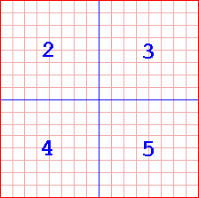
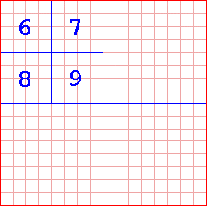
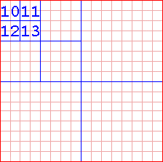
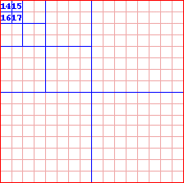
Pathfinding
CW208-3-2014/15, Lecture 17

Slide 39
Pathfinding
Root represents the entire map
2
3
4
5
6
7
8
9
10
11
12
13
The tree structure used to
represent the previous map
…
…
CW208-3-2014/15, Lecture 17

Slide 40

Quadtrees
Each node in a quadtree has 4 children (top left, top right, bottom left, bottom right quads)
Consider a large map with a large impassable lake in one part of it:
Create a quadtree out of the map so the tree is full to a certain number of levels (e.g. 3 or 4)
CW208-3-2014/15, Lecture 17

Slide 41
Quadtrees
For each quad on the lowest level of the tree, check the midpoint of each quad
  1. If all four quad’s midpoints are not obstructed remove that branch of the tree
  2. When the lowest level is complete go up to the next level and continue removing nodes – only if all four branches of each node go down to the same level
Eventually, the quadtree will resemble the following:
CW208-3-2014/15, Lecture 17

Slide 42
Pathfinding
.
.
.
.
.
.
.
.
.
.
.
.
.
.
.
.
.
.
.
.
.
.
.
.
.
.
.
.
CW208-3-2014/15, Lecture 17

Slide 43
Quadtrees
Now consider that each point in the graph represents a waypoint
The points are connected using lines to form a graph – finding a path through the graph involves following the lines until you reach the desired waypoint
CW208-3-2014/15, Lecture 17

Slide 44
Quadtrees
This method is popular in the FPS genre
Waypoints could represent a game item e.g. a weapon or powerup
The AI decides what item it wants then attaches itself to the graph and follows the waypoints until it gets to the point that has the item it wants.
CW208-3-2014/15, Lecture 17

